Slide 1

Male and Female Walking Times

Slide 2
Design the Study
As a team we wondered if males or females walked more. The more we thought and discussed this, the more we realized that this was a very broad subject matter. After much thought, we decided on a research question:
  Is there a relationship between gender and walking time to school?
  Ho: There is no difference between gender and walking times.
    Ho: µ₁ = µ₂
  Ha: There is a difference between gender and walking times.
    Ha: µ₁ ≠ µ₂
  Level of significance: 0.05

Slide 3

Design the Study – cont.
We determined to sample 25 people in each of The Ricks, Austin, Smith, Clark, and Benson buildings.
We used the stratified sampling method.
Each individual would be asked if they walked to school, and if so we would record their gender and walking time.

Slide 4

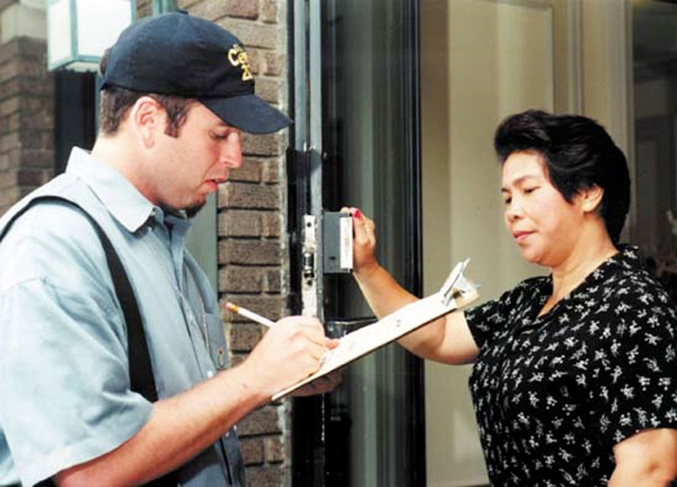
Collect the Data
We surveyed 69 Females and 56 Males
Approximately 30% of those surveyed did not walk to school

Slide 5
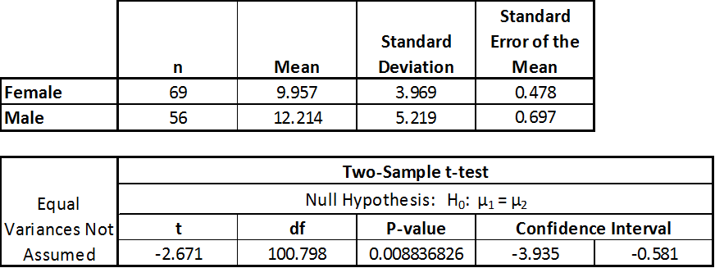
Describe the Data
The average female walking time was 9.957 minutes, with a standard deviation of 3.969. The average male walking time was 12.214 with a standard deviation of 5.219. The calculated T-Value was -2.671. The calculated P-Value was .008. This is well below our level of significance of .05.

Slide 6
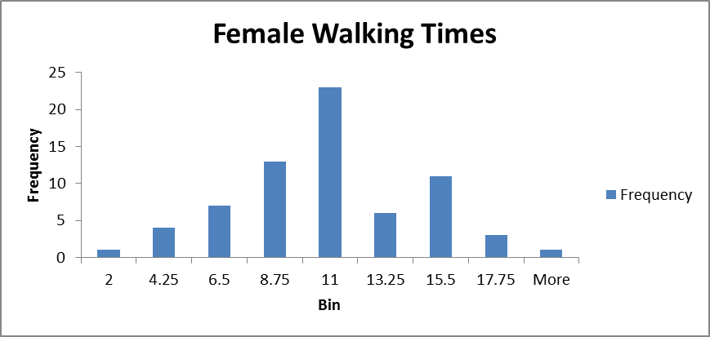
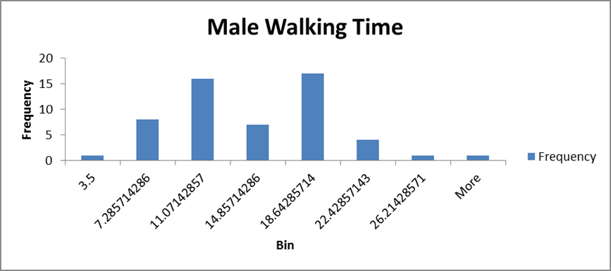
Histograms

Slide 7
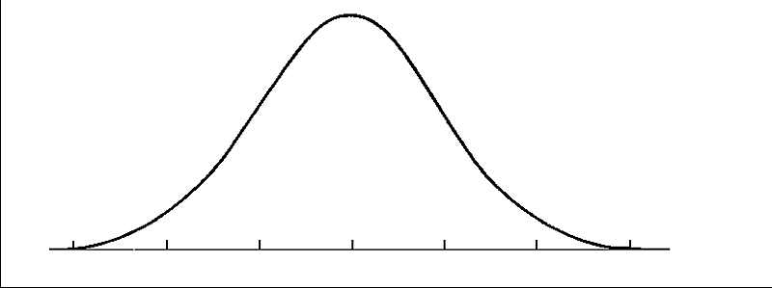
Make Inference
Our data met all the requirements for a hypothesis test. Our sample size was large, and therefore we used the Central Limit Theorem to determine that our sample means are are normally distributed.

Slide 8
Make Inference
  Is there a relationship between gender and walking time to school?
  Two sample T-test
  Ho: There is no difference between gender and walking times.
    Ho: µ₁ = µ₂
  Ha: There is a difference between gender and walking times.
    Ha: µ₁ ≠ µ₂
Alpha level: .05
T= -2.671
P=.008

Slide 9

Make Inference
.008<.05
We therefore reject the null.
There is sufficient evidence to suggest that there is a difference between walking times to school and gender.

Slide 10
Further Investigation
We determined that there is a difference in walking times between male and female.
To further investigate this we would change our hypothesis test to:
      Ho: µ₁ = µ₂
      Ha: µ₁ < µ₂
    If we failed to reject this null, we would then test
      Ho: µ₁ = µ₂
      Ha: µ₁ > µ₂
We would do both tests to determine which gender walked more.

Slide 11
Take action
1) If you were to redo this project, what would you do differently and why?
  We would reduce our study to single male and female students.
  Perhaps we would have this be an online survey.
  We would try a systematic sampling method.
2) Since you will probably not take any direct action, who could use the results of your project and how could they use them?
  The developers in the area could use this data to know were to build male and female housing.
3) What did you learn about your research question as a result of this project?
  We could redefine our Ha: so that we have a greater than test. We could then use this to determined which gender walks more.

